Slide 1
Tournament Management Software
UA Badminton Club
Status Update 1
Junfeng Xu, Enfa George, Rupal Jain, Urvika Gola

Slide 2

Structure of the Presentation
Introduction
System Description
Current Status
Project Management
Reflection

Slide 3

Introduction
Notes:
1 min

Slide 4
Introduction
Plan for this iteration
Team accomplishment
Project changes overview
Notes:
1.5

Slide 5

System Description
Notes:
2 minutes

Slide 6
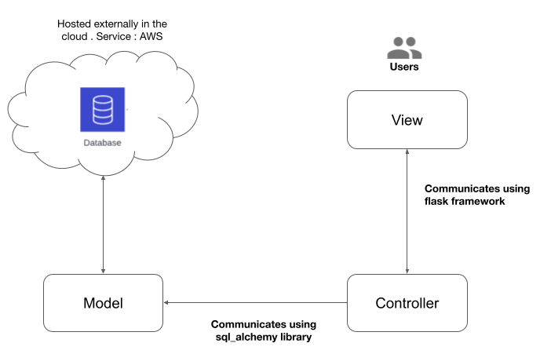
System Description & Interaction

Slide 7
System Challenges
Scalability
Latency
Integration Testing
Notes:
Our software has four main modules.
Seed & Draw: The system generates tournament schedules based on the number of players and teams, and it assigns players to matches based on their proficiency levels. The system also allows tournament organizers to manually adjust the schedule if necessary. The system can be configured to schedule matches at specific times and dates.
Match Management: The system gives the admin the ability to update matches live. It tracks the progress of each match and displays the results on a live scoreboard. Players and spectators can access the scoreboard from their mobile devices or computers to see the current score, game and set counts, and other relevant information.

Slide 8
Main Modules
Registration
User Management
Seed & Draw
Match Management
Notes:
Our software has four main modules.
Seed & Draw: The system generates tournament schedules based on the number of players and teams, and it assigns players to matches based on their proficiency levels. The system also allows tournament organizers to manually adjust the schedule if necessary. The system can be configured to schedule matches at specific times and dates.
Match Management: The system gives the admin the ability to update matches live. It tracks the progress of each match and displays the results on a live scoreboard. Players and spectators can access the scoreboard from their mobile devices or computers to see the current score, game and set counts, and other relevant information.

Slide 9
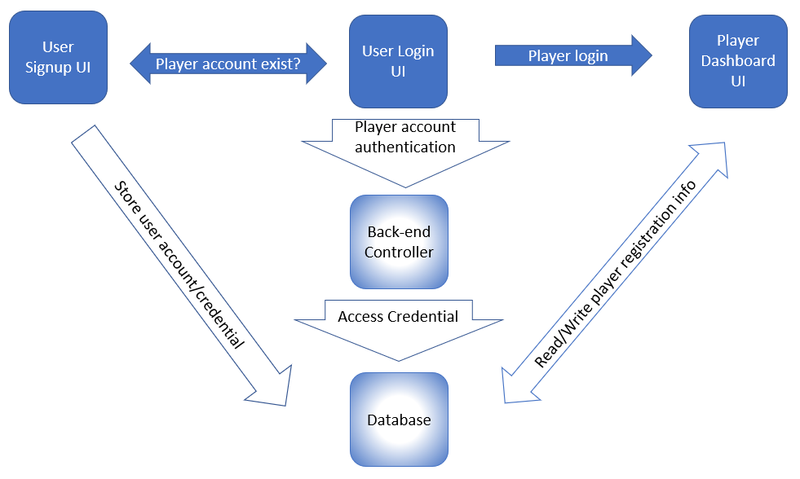
A sample block diagram

Slide 10
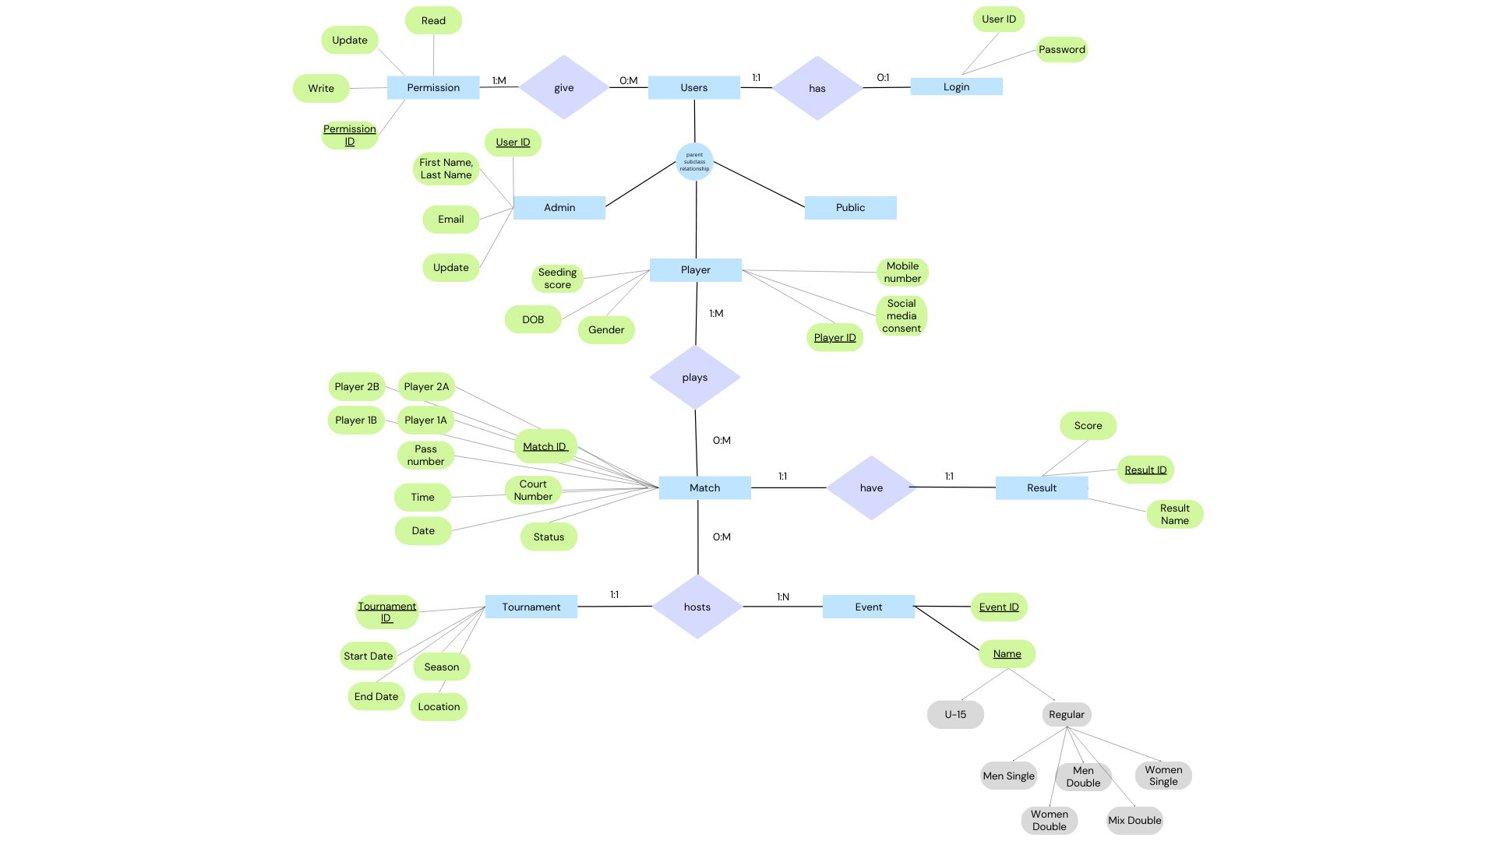
ER Diagram

Slide 11
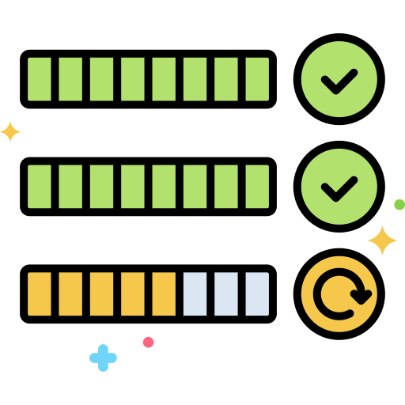
Current Status

Slide 12
Sprint goal & Status
Project Design and Setup
Signup and Sign In
Player dashboard and admin dashboard front-end interface.
Notes:
Our software has four main modules.
Seed & Draw: The system generates tournament schedules based on the number of players and teams, and it assigns players to matches based on their proficiency levels. The system also allows tournament organizers to manually adjust the schedule if necessary. The system can be configured to schedule matches at specific times and dates.
Match Management: The system gives the admin the ability to update matches live. It tracks the progress of each match and displays the results on a live scoreboard. Players and spectators can access the scoreboard from their mobile devices or computers to see the current score, game and set counts, and other relevant information.

Slide 13



Slide 14

Customer Need
Customer desired overall experience change.
Feedback for our design.

Slide 15
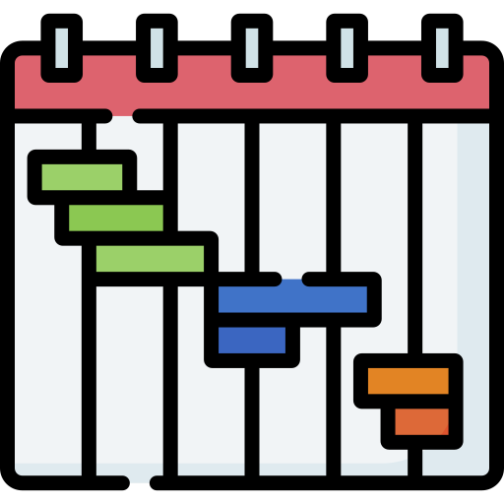
Project Management
Notes:
2 minutes 30 seconds
Let’s now get into the project management principles

Slide 16
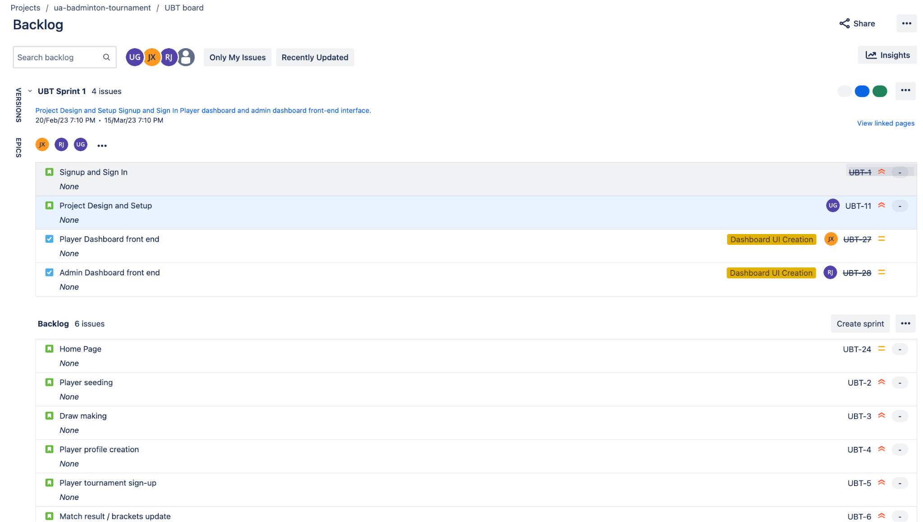
Jira Dashboard - Before Sprint Planning, Product Backlog
Notes:
One of the 3 tools we utilized is the Jira to plan our sprints in Agile and Extreme Programming methodology. Before sprint planning, we made sure that the product backlog was well-defined, containing a prioritized list of user stories. The right red box highlights the priorities corresponding to the user story.

Slide 17
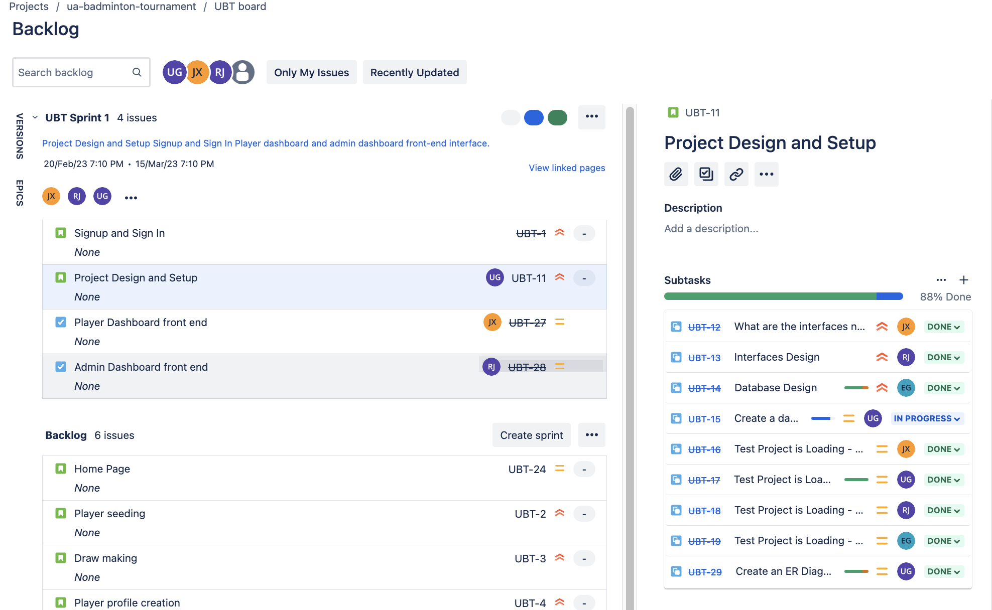
Jira Dashboard - During Sprint Planning
Notes:
During sprint planning, we focused on three critical areas:
Sprint goals: It's essential to get the team to think about the essence of the sprint and what value will we create for our customers when the sprint concludes.
Sprint tasks: After this, We identified the specific tasks and user stories to be picked from product backlog that will help to fulfill the Sprint Goal.
Sprint execution: We planned how the tasks would be accomplished by dividing into subtasks. and who would be responsible for each

Slide 18
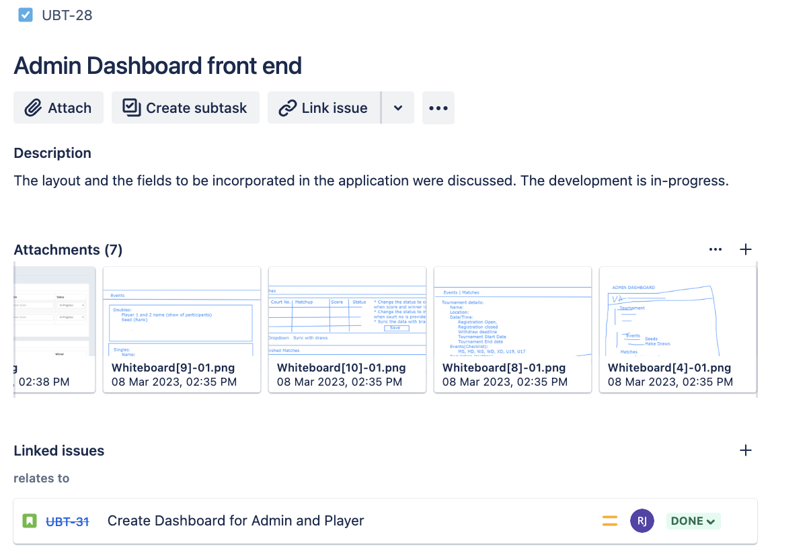
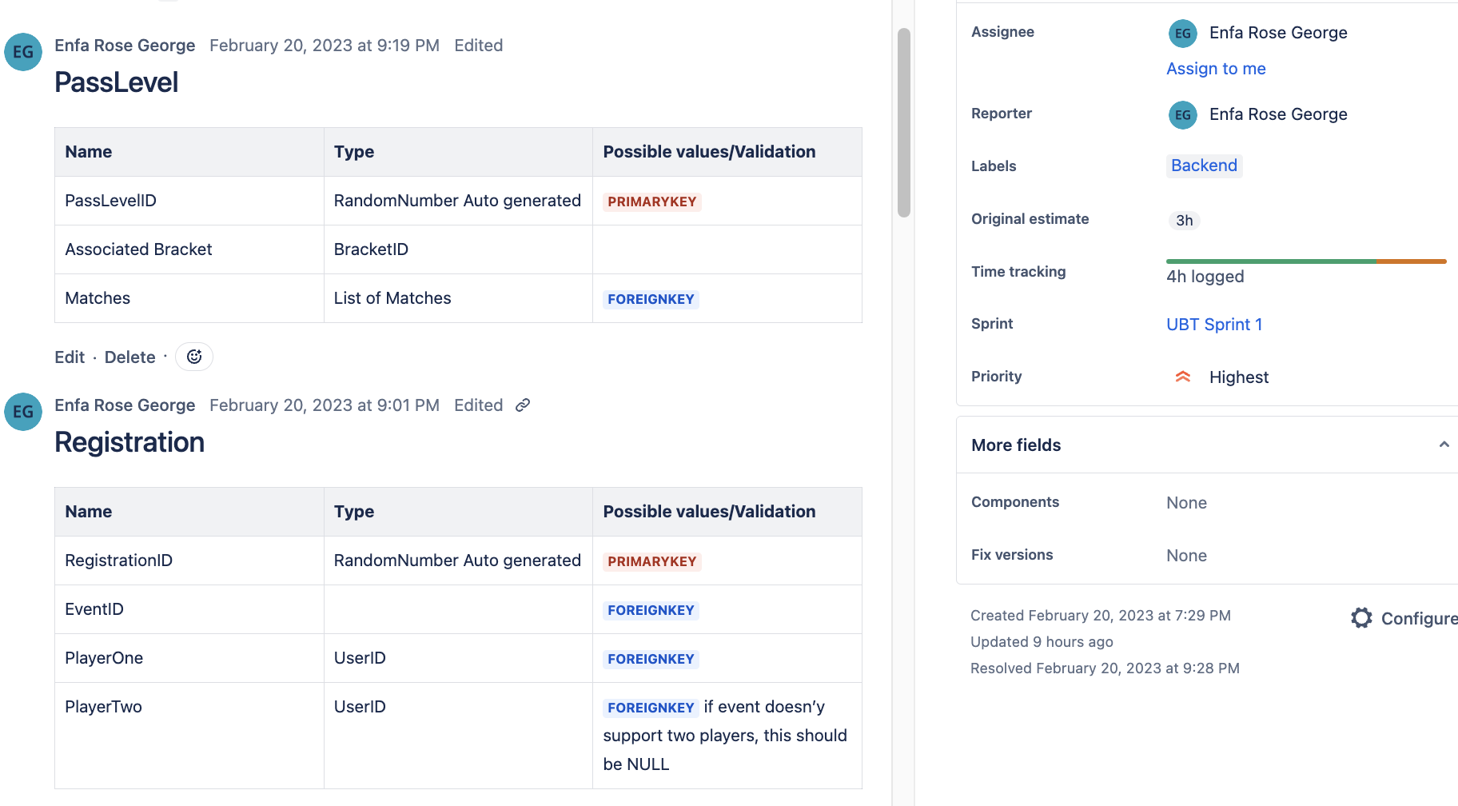
Jira Dashboard - Maintaining Updates
Notes:
By utilizing Jira to manage our sprints, we were able to track our progress, track our time making sure we are not underestimating and overestimating timelines and make adjustments as needed to ensure that we stayed on track towards achieving our sprint goals.

Slide 19
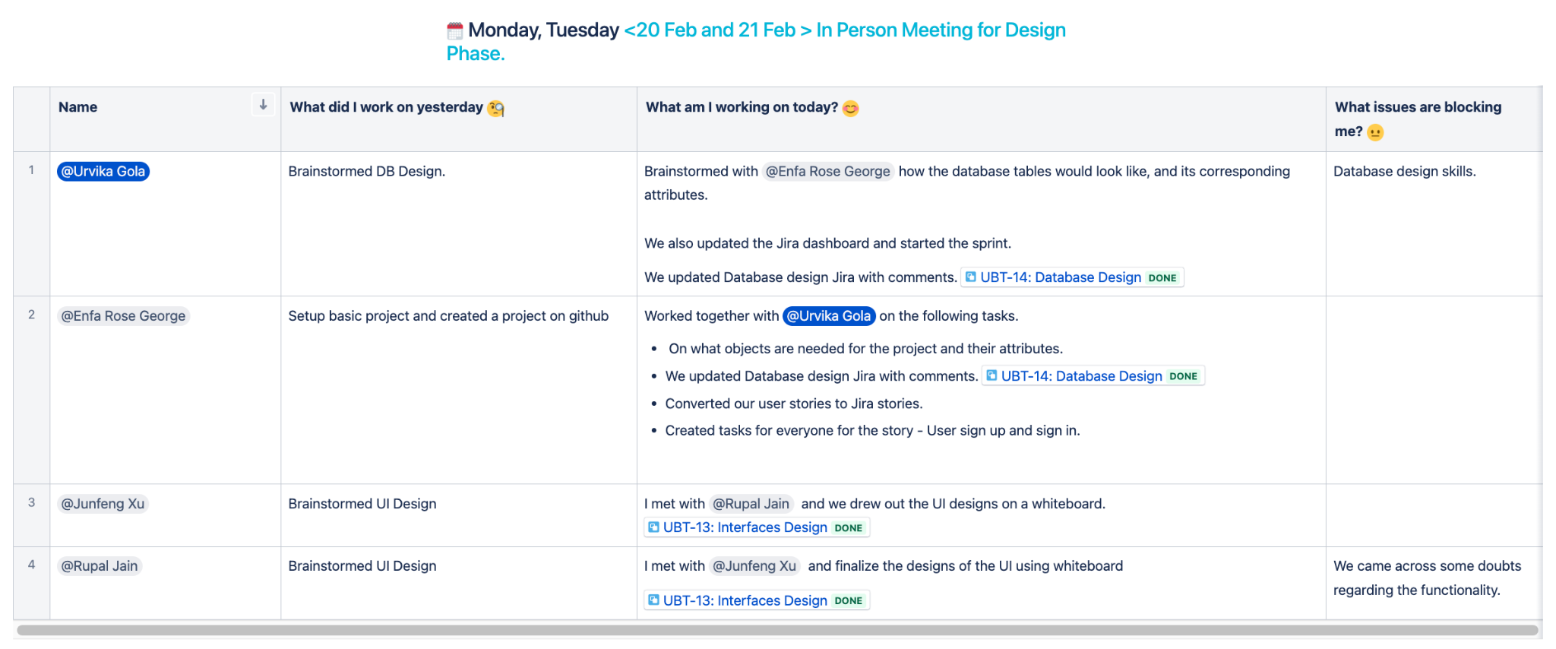
Daily Stand Ups
Notes:
In additional to that, We also created a Daily Dashboard in Confluence, which helps us track progress and identify roadblocks.
We preferred meeting in person as we realize that it is essential skill in Extreme Programming to build rapport to have a cohesive team.

Slide 20
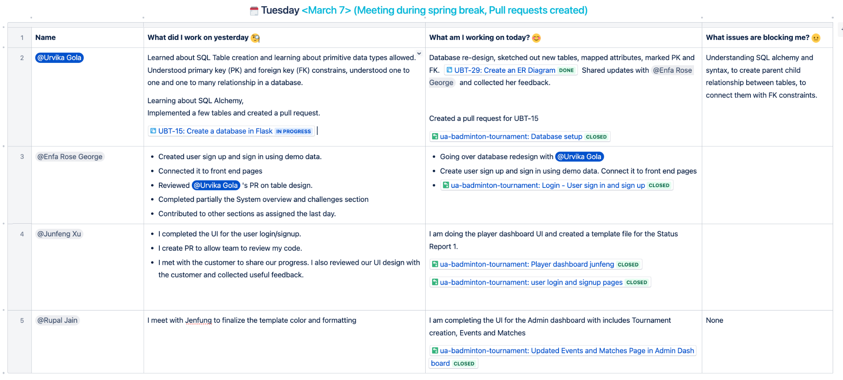
Daily Stand Ups
Notes:
We also linked our Github version control and Jira to Confluence in order to have everything under one umbrella.

Slide 21
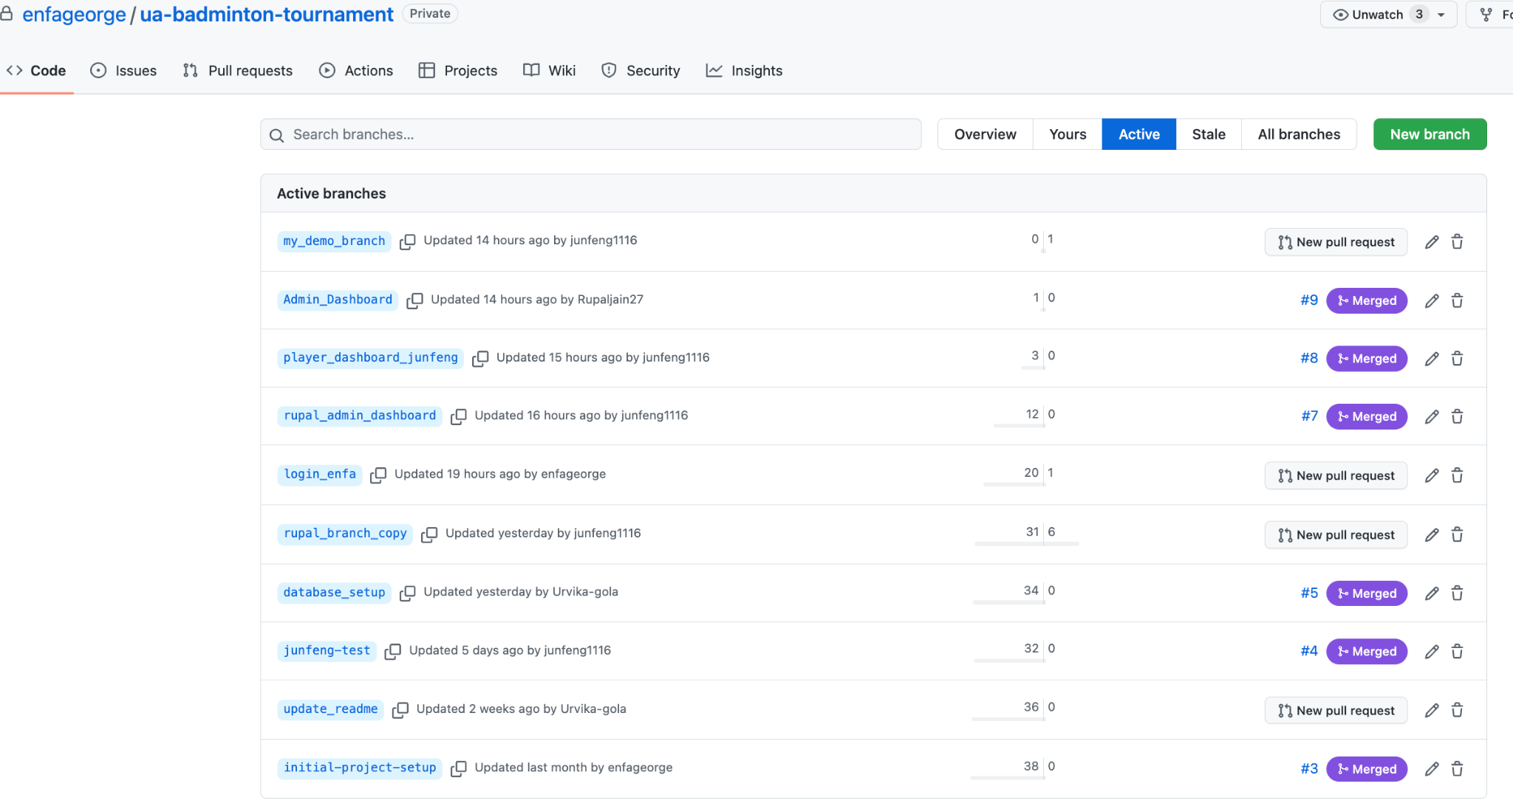
Version Control
Notes:
Snapshot of our github repository where we maintain versions and changelog.
To conclude, By using Jira, confluence, and github, helped to provide visibility into progress made towards the sprint goals to deliver value to our customers on time.
Transferring to rupal.

Slide 22

Reflection
Notes:
2 minutes
Let’s move on to the reflection now.

Slide 23
Challenges
Design and Implementation of DB
Hosting the database on a centralized server
Time Scheduling
Familiarity with Technology
Notes:
We faced several challenges in developing our system:
Firstly, designing and implementing the database using SQLAlchemy and Flask framework was a significant challenge due to the team's limited expertise.
Secondly, hosting the database on a centralized server required selecting an appropriate hosting platform that everyone could access.
Thirdly, scheduling meetings was difficult due to our team's varied schedules.
Finally, developing the frontend web application was a challenge since it was our first time building a complete frontend from scratch. We spent additional time researching and experimenting with different frameworks and tools to ensure that the frontend should be user-friendly, responsive, and visually appealing while maintaining compatibility with the backend functionalities.

Slide 24
Sprint Retrospective & Reflection
What went well?
What didn’t go well?
How can we improve
Notes:
What went well? Ans: Most part of the plan worked well.
We achieved our aim of Frontend development over the initial plan.
We were successful in implementing new techniques for database creation using SQL Alchemy and Flask framework.
The use of tools such as Scrum dashboard and Atlassian Confluence made us achieve effective project management.
We were able to setup the project using GitHub which helped version control and collaboration.
What didn’t go well?
Ans: There are few things that didn’t go well:
Frontend redesigning: We received feedback from the customer for improvements after delivering a comprehensive frontend. We held additional meetings to gather feedback from the team as well and after all of the considerations, we developed a more cohesive design.
We have to go through Database redesign and hosting issues: We discovered a design flaw in the initial database structure that required a complete redesign which required additional time and resources, but we were able to learn from the experience and created a robust database structure. Also, hosting the database on a centralized server is a significant challenge, but we are exploring efficient measures to solve the issue.
How can we improve?
Ans: We have identified a couple of ways to overcome these issues. Firstly, we plan to improve communication among team members by encouraging open sharing of ideas and feedback. This will help in effective collaboration and reduce the space for errors. Secondly, we will work to improve our project estimation processes by conducting more thorough research and analysis before setting project goals early on in the project. By developing alternative plans, we can address these issues quickly and efficiently, enabling us to deliver the project on time. This marks the end. Thank you

Slide 25

Notes:
We are now open for questions and answers.

